Slide 1
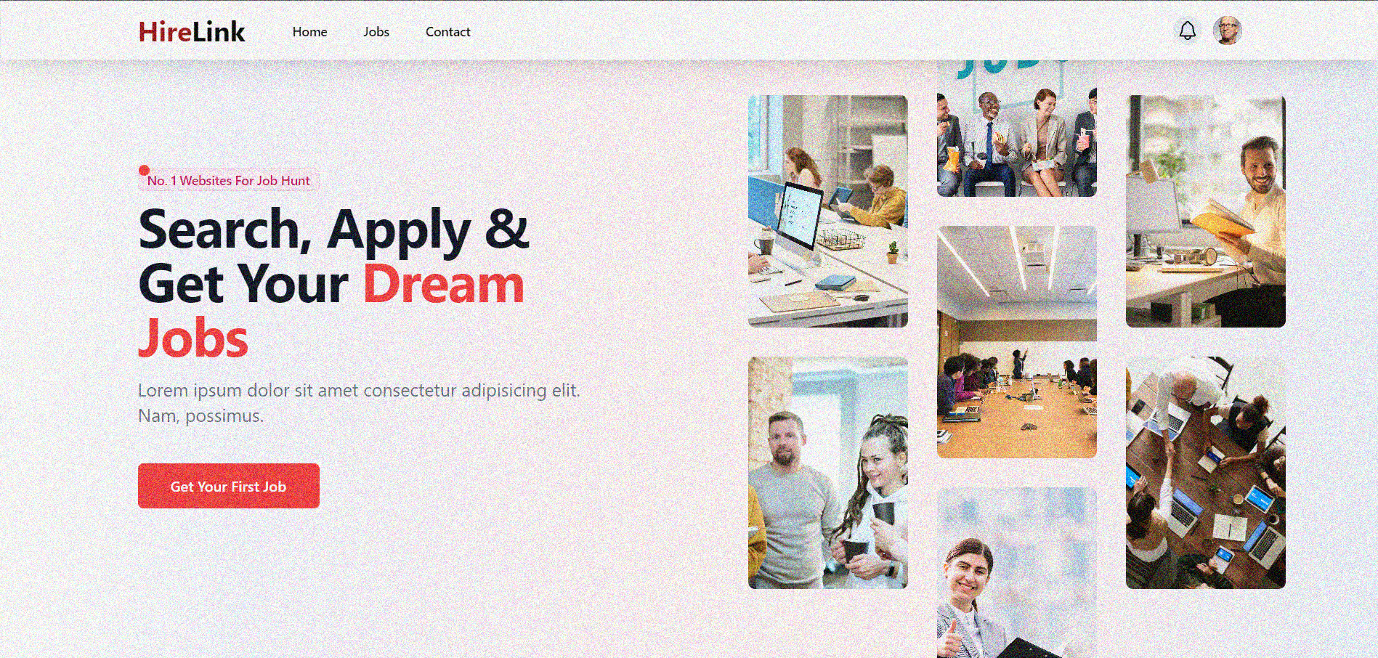
HireLink - Job Portal
Karan Parmar ( E NO. - 22032211123)
Mihir Prajapati ( E NO. - 22032211205)

Slide 2

A Project Presentation On
Job Portal
Submit To :-
Acharya Moti Bhai Patel Institute Of Computer Studied
Ganpat University Kherva - 384012
Guide By – Prof Falguni Suthar

Slide 3

PROJECT PROFILE
Project Name :- | Job Portal - HireLink
Objective :- | For Provide Job portal To Public
Front End :- | ReactJs,DaisyUi,TailwindCSS
Back End :- | NodeJs
Editor :- | Visual Studio Code
Application Type :- | Website
Developed For :- | Acharya Motibhai Patel Institute Of Computer Studied
Team Member :- | Karan Parmar (22032211123) Mihir Prajapati(22032211205)
Internal Guide :- | Prof. Falguni Suthar
Database | MongoDb
Framework | ExpressJs

Slide 4
EXISTING SYSTEM
Pre-Existing System :
Job details are stored in paper work
Maintenance is a huge problem
Updating , Changes in details is a big task
Limited Accessibility : without an online presence , applicant can
only access the rental service by physically visiting the rental location

Slide 5
NEED FOR NEW SYSTEM
Our Purpose :
Maintenance is easy and performance is good.
Mainly the system has automated the transportation process. As data
is maintained electronically , it’s easy for a person to update the details,
Which has overcome the tedious updating in previous system.
Customer Convenience : In an increasingly digital world
24/7 Availability : our online platform can operate 24/7 , allowing applicant
to apply jobs at any time day or night.

Slide 6
HARDWARE REQUIREMENT (SERVER SIDE)
HARDWARE
Processor : Intel core i3 OR above
Ram : 4GB or above
Hard – Disk : 256GB or above
SOFTWARE
Database System : MongoDB
Operating System : Windows 7 or above

Slide 7
SOFTWARE REQUIREMENT (CLIENT SIDE)
HARDWARE
Processor : Intel core i3 or above
Ram : 2GB or above
Hard-Disk : 256GB or above
SOFTWARE
Browser : chrome or Any browser
Operating System : windows or any OS

Slide 8
Flow chart (Recruiter)
Start
Username/password
yes
Login/verify
no
Manage Advertisement
Manage jobs
Applicant response
Manage User
Stop

Slide 9
Flow chart (User)
Start
View Advertisment
View job post
Want to Apply
no
Yes
Register User
Signup
no
Yes

Slide 10
Flow chart (User)
Login
Apply Job
Manage Profile
end

Slide 11
Context Level
Data Flow Diagram
request
0.0
Recruiter
User
Job Portal
response
response

Slide 12
level 1 Admin
Login
details
Request id/pass
1.0
Login
Recruiter
User
Response
Response
request job info
2.0
manage advertisement
job info
Job
Response
Response

Slide 13
Recruiter
3.0
access job
check job
Mange Job
Job
Response
Response
4.0
check job applicant
check job applicant
Manage Job Application
Job
Response
Response
5.0
access users
check users
Manage Users
Users
Response
Response

Slide 14
level 1 User
username/
password
1.0
request advertisment
User
Job
View Advertisement
Response
Response
job details
2.0
job info
Job
Job Post
Response
Response
user details
3.0
user info
Registration
/ login
User
Response
Response

Slide 15
User
user and job details
4.0
user and job details
Job
Apply Job
Response
Response
user all info
5.0
user all info
Manage Profile
User
Response
Response

Slide 16
Data Dictionary
Sr. No | Tabel Name
1 | application
2 | company
3 | job
4 | user
5 | recruiter

Slide 17
Application Model
Sr | Field Name | Data type | Contraint | Description
1 | job | object | reference | job details
2 | applicant | object | reference | applicant details
3 | status | string | required | status details
4 | timestamps | date | required | current date

Slide 18
Company Model
Sr | Field Name | Data type | Constraint | Description
1 | companyName | string | required | name of company
2 | description | string | required | description details
3 | location | date | required | location details
4 | userId | object | reference | user information
5 | timestapms | date | required | current date

Slide 19
Jobs Model
Sr | Field Name | Data type | Contraint | Description
1 | title | string | required | job details
2 | description | string | required | description
3 | requirement | string array | required | list of skills
4 | salary | number | required | salary details
5 | location | string | required | location details
6 | jobType | string | required | type of job
7 | position | number | required | available position
8 | company | object | reference | company details
9 | experiencelevel | number | required | experience details
10 | application | object | reference | job applicant
11 | createdBy | object | reference | user information
12 | timestapms | date | required | current date

Slide 20
User Model
Sr | Field Name | Data type | Contraint | Description
1 | fullname | string | required | name of user
2 | email | string | unique | email of user
3 | phoneNumber | number | required | number of user
4 | password | string | required | password details
5 | role | string | required | recruiter or jobseeker
6 | profile | object | unrequired | profile information
7 | timestapms | date | required | current date

Slide 21
Recruiter Model
Sr | Field Name | Data type | Contraint | Description
1 | fullname | string | required | name of user
2 | email | string | unique | email of user
3 | phoneNumber | number | required | number of user
4 | password | string | required | password details
5 | role | string | required | recruiter or jobseeker
6 | timestapms | date | required | current date

Slide 22
ER Diagram
website
name
Post
Company
M
name
description
email
1
M
1
Recruiter
Manage
M
Job
job type
role
1
M
M
title
Manage
name
View
M
1
status
email
User
M
role
Application
job
1
Apply

Slide 23
Process Description
The Job Portal System is a platform designed to connect job seekers with potential employers. The system consists of two main user types: Recruiter and User (Job Seeker).
The Job Portal System connects Job Seekers (Users) with Recruiters (Employers).
Recruiters can post job openings, manage applications, and communicate with candidates. They review profiles, shortlist applicants, and oversee the hiring process.
Users (Job Seekers) can create profiles, search for jobs based on preferences, and apply directly to openings. The system allows users to track their application status and receive updates from recruiters. It streamlines job searching and recruitment, offering a centralized platform for both employers to manage hiring and job seekers to find and apply for relevant job opportunities efficiently.

Slide 24
Process-Algorithm
Recruiter Process Algoritham
Step 1 :- Start
Step 2 : recruiter input email and passsword
Step 3 :- if valid: redirect to recruiter dashboard else display error message.
Step 4 :- recruiter add compnay and job posting.
Step 5 :- Edit compny
Step 6 :- Edit Job
Step 7 :- manage applicants
Step 8 :- give response of the applicant like (accepted,rejected or pending)
Step 9 :- Logout
Step 10 :- Exit

Slide 25
Process-Algorithm
User(Job seekeer) Process Algoritham
Step 1 :- Start
Step 2 : user input email and passsword
Step 3 :- if valid: redirect to recruiter dashboard else display error message.
Step 4 :- user view Jobs application.
Step 5 :- apply job application if resume is upload if not then upload resume.
Step 6 :- waiting for response.
Step 7 :- Logout
Step 8 :- Exit

Slide 26
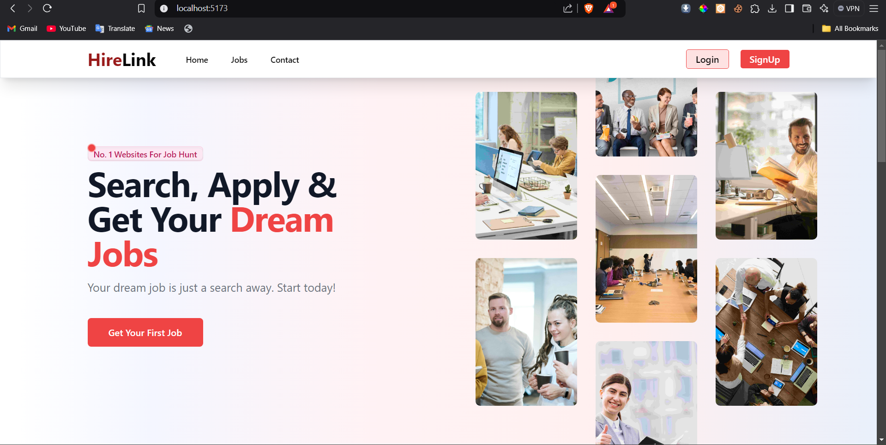
Input Design (User)
Home Page

Slide 27
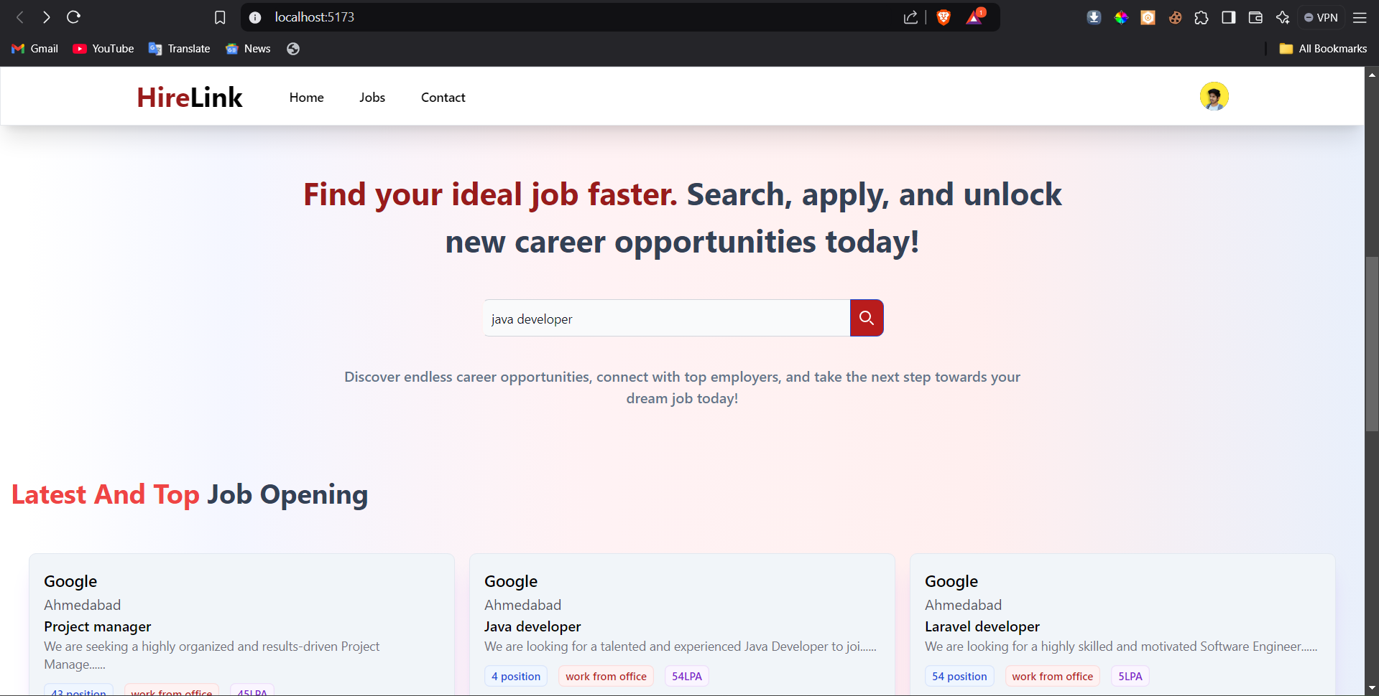
Input Design (User)
Home Page sesarch

Slide 28
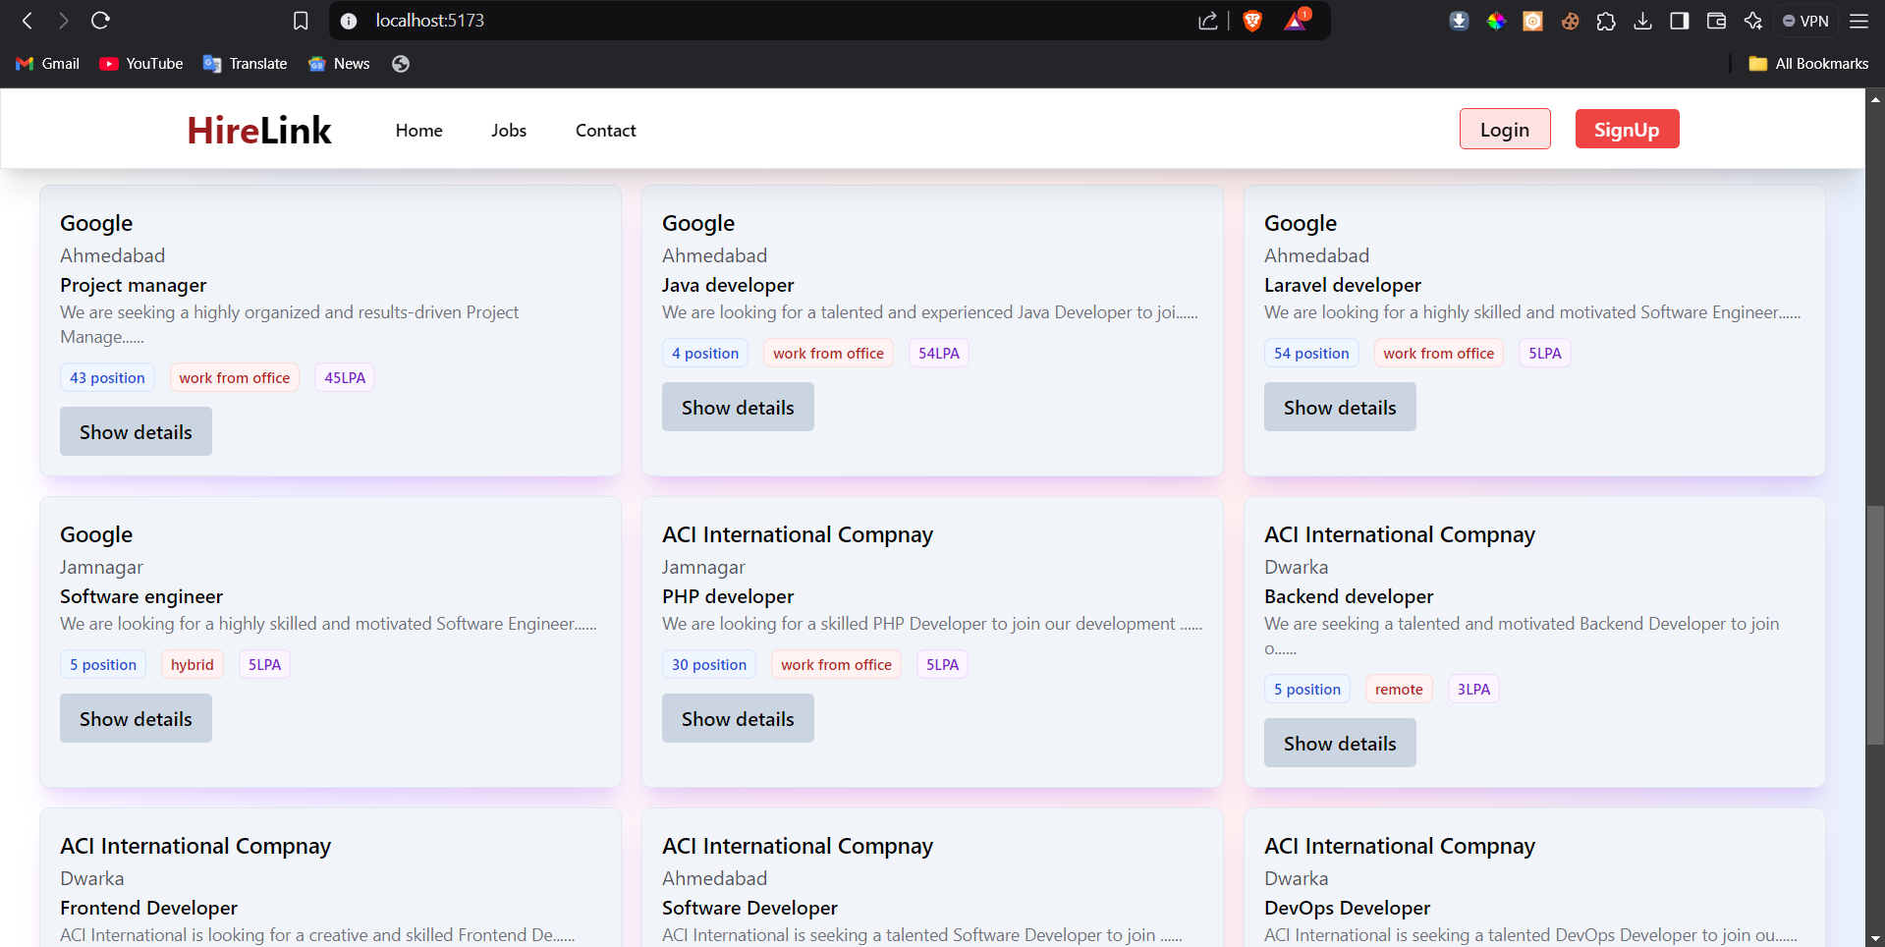
Input Design (User)
Home Page latest job opening

Slide 29
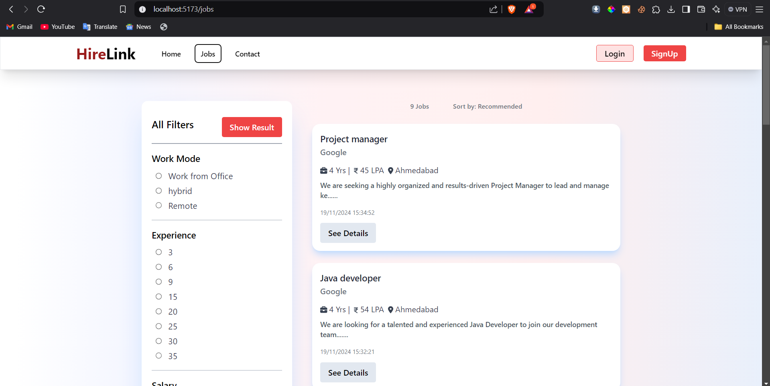
Input Design (User)
Jobs Page

Slide 30
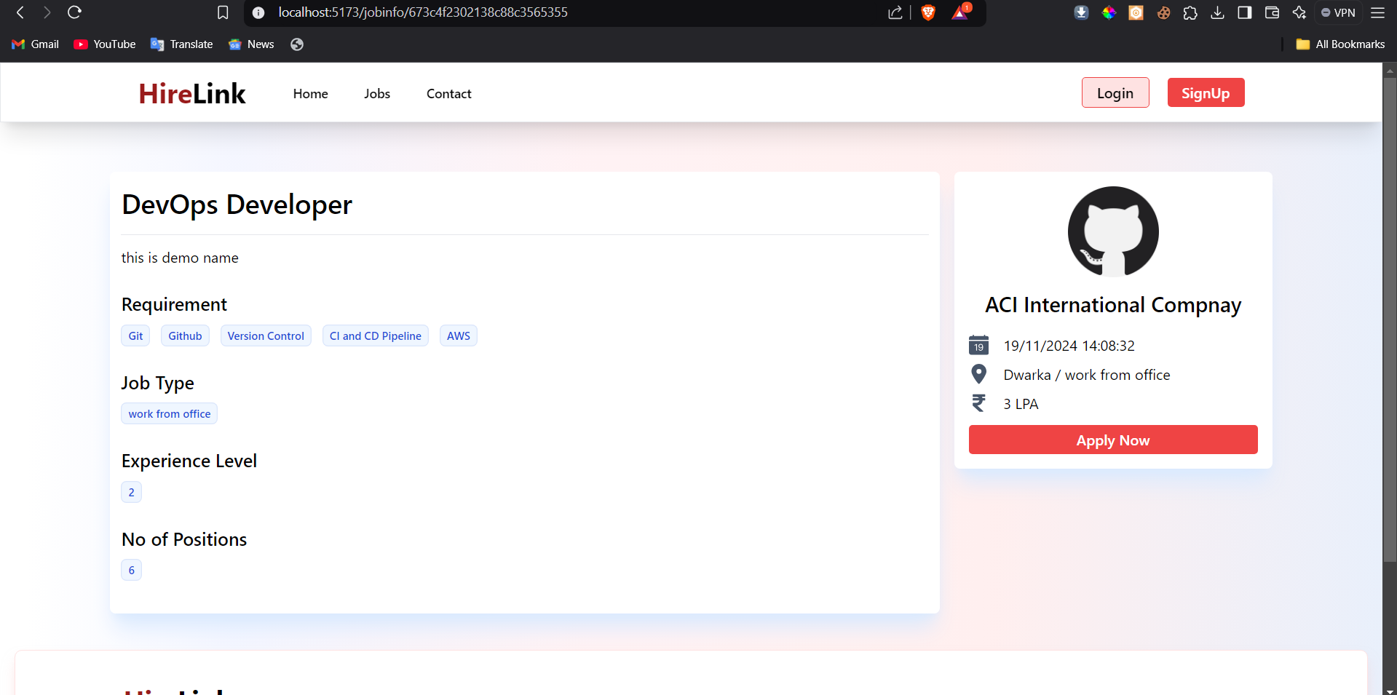
Input Design (User)
Jobs post page

Slide 31
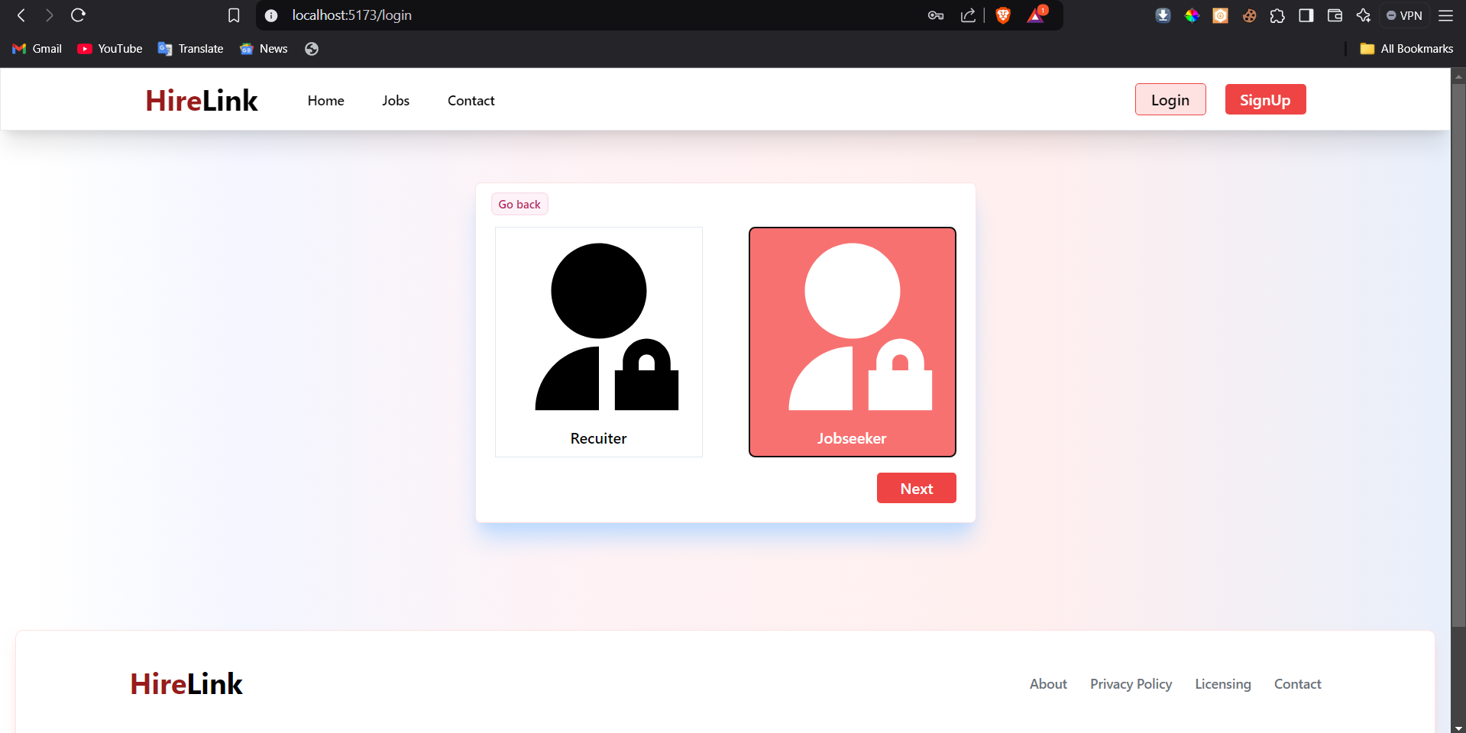
Input Design (User)
register page choice

Slide 32
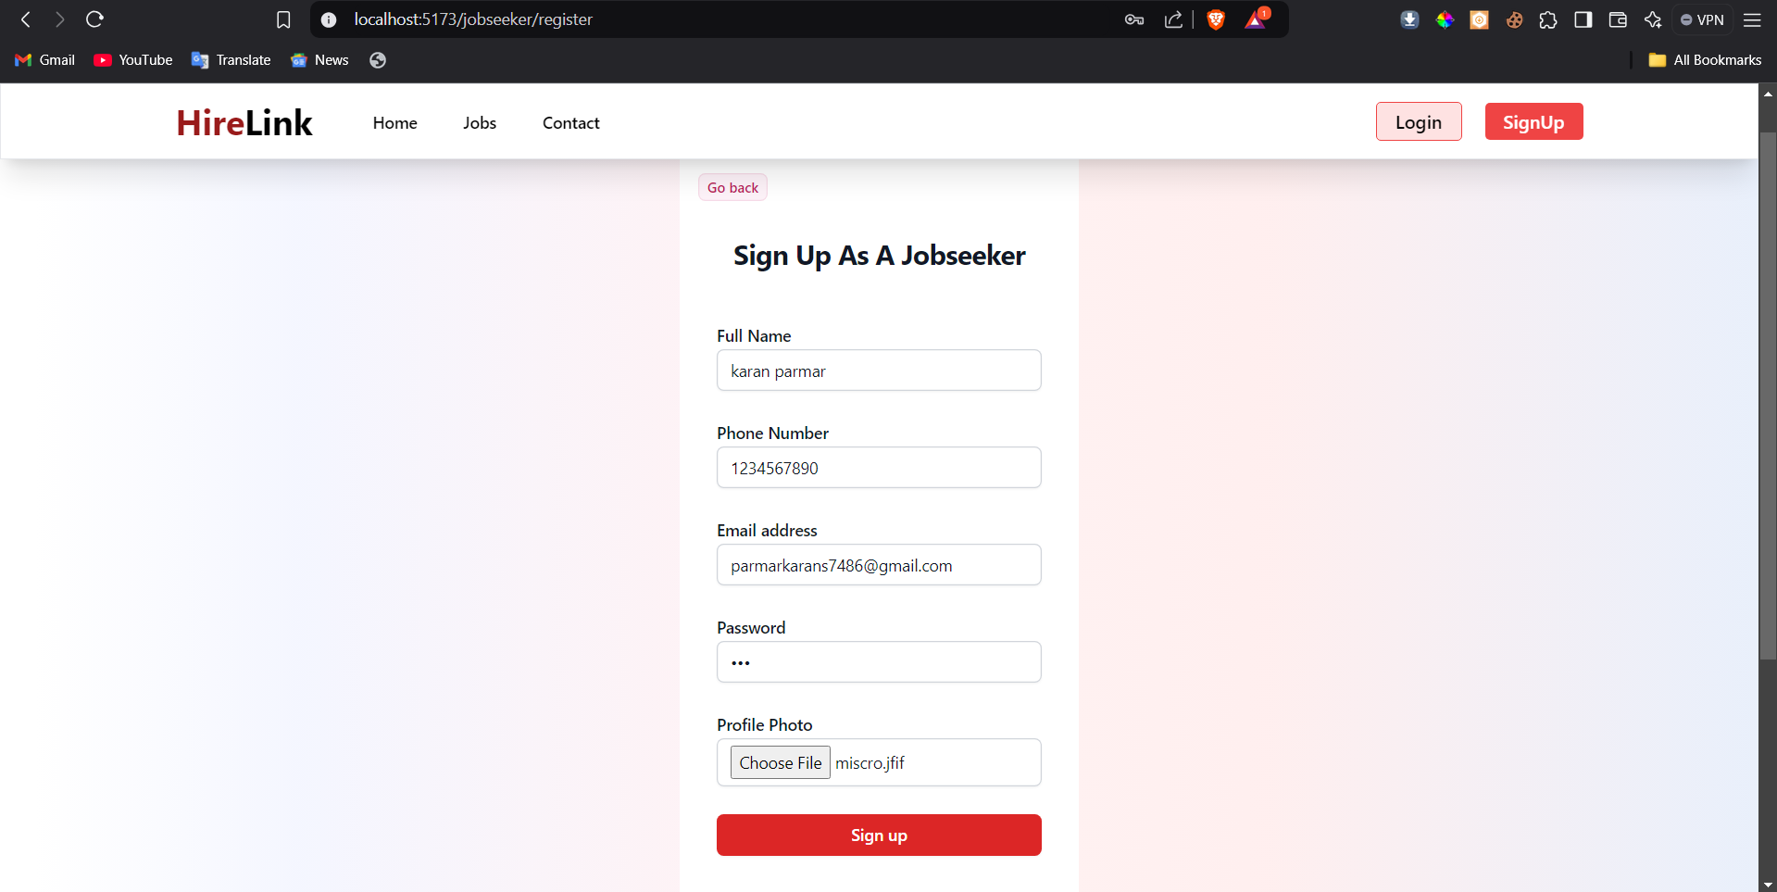
Input Design (User)
register for user

Slide 33
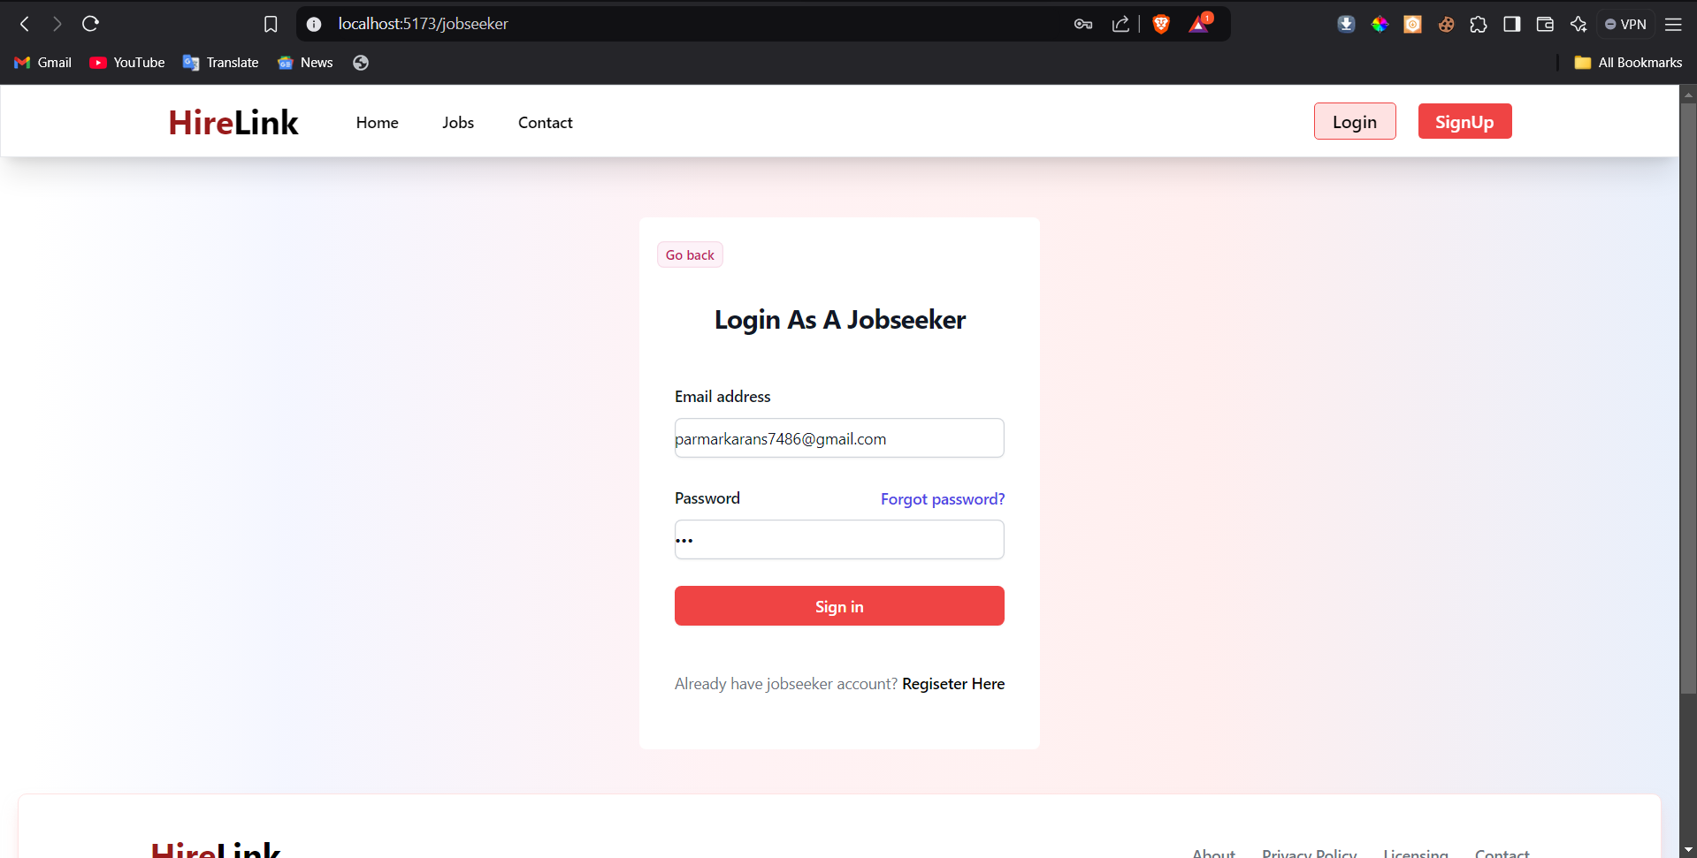
Input Design (User)
login for user

Slide 34
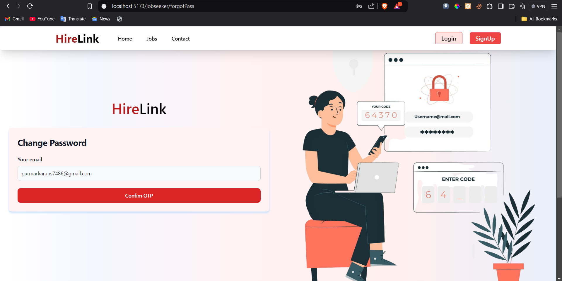
Input Design (User)
forget password page for user

Slide 35
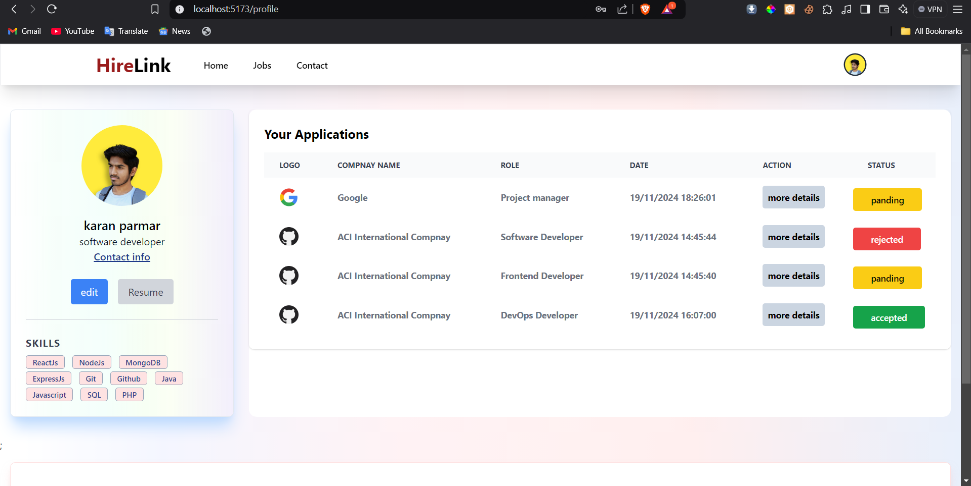
Input Design (User)
profile page

Slide 36
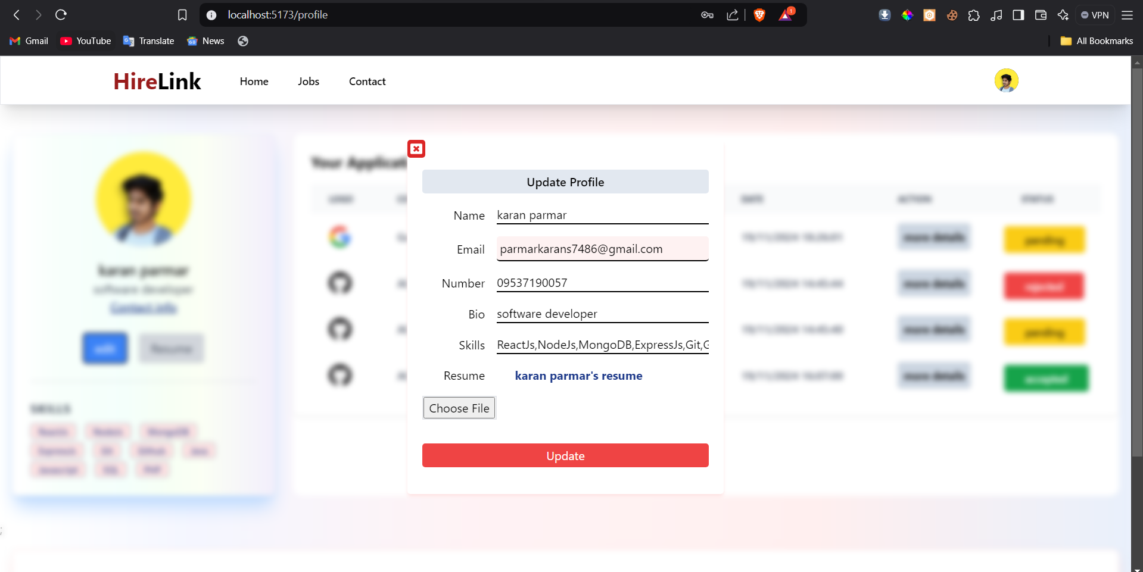
Input Design (User)
update profile page

Slide 37
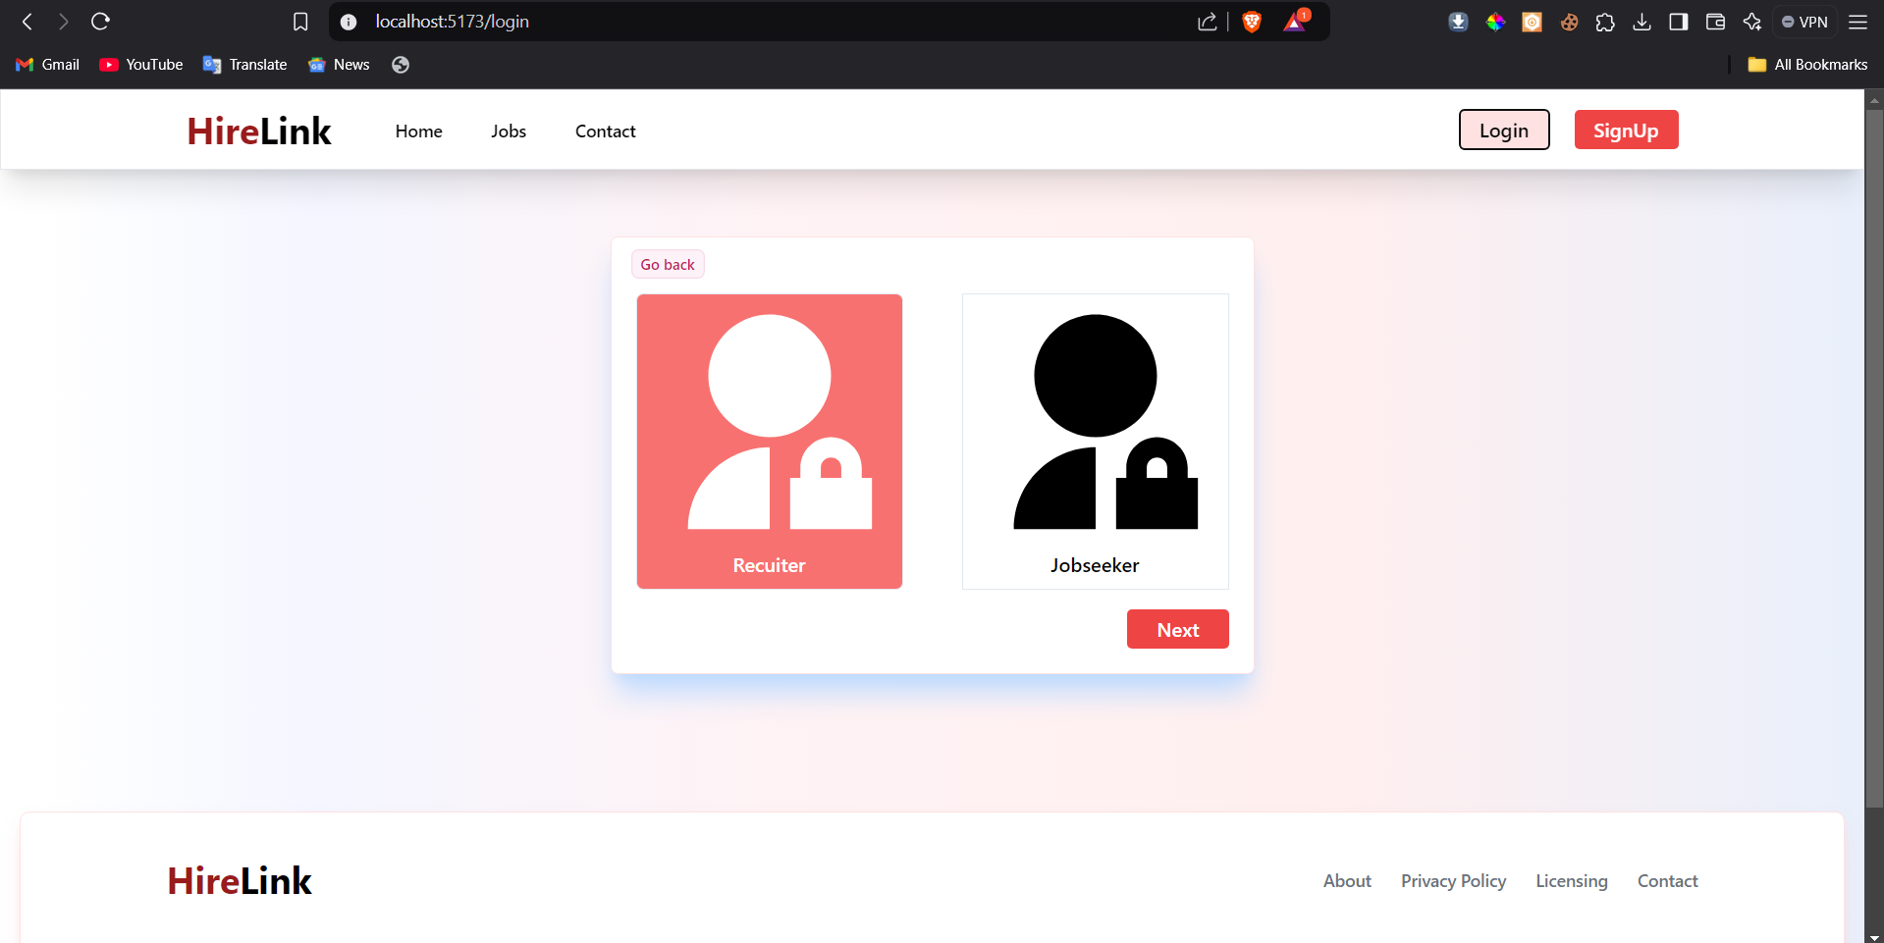
Input Design (Recruiter)
Recruiter selection

Slide 38
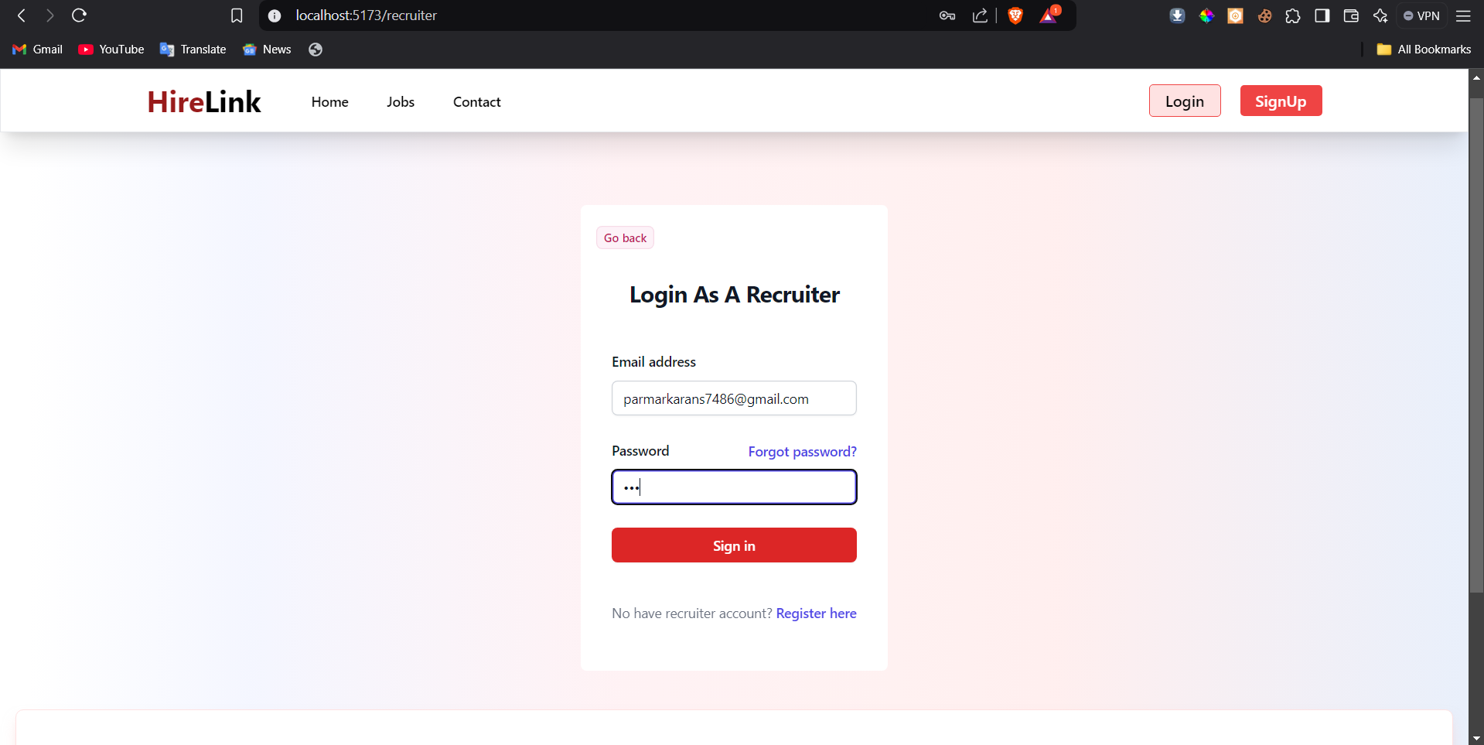
Input Design (Recruiter)
Recruiter login

Slide 39
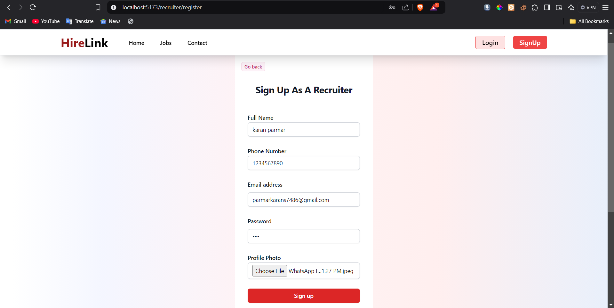
Input Design (Recruiter)
Recruiter register

Slide 40
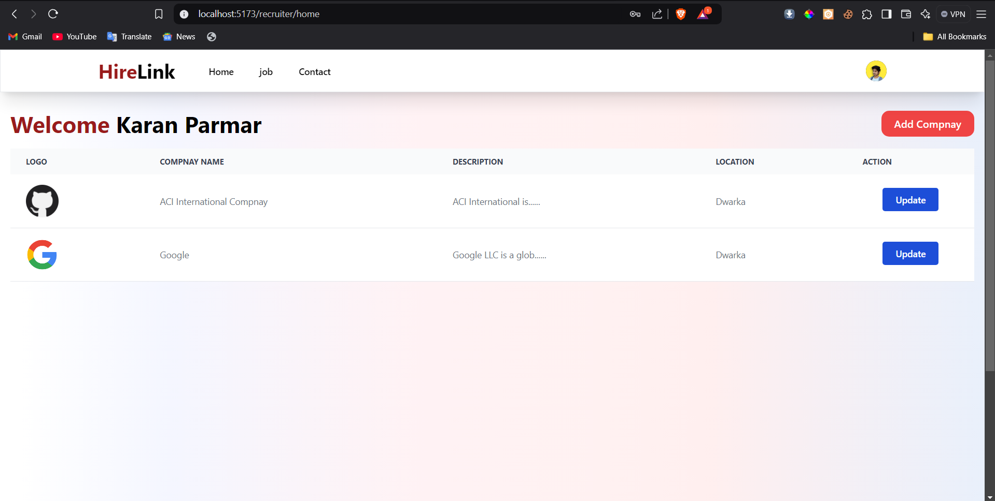
Input Design (Recruiter)
Recruiter dashboard

Slide 41
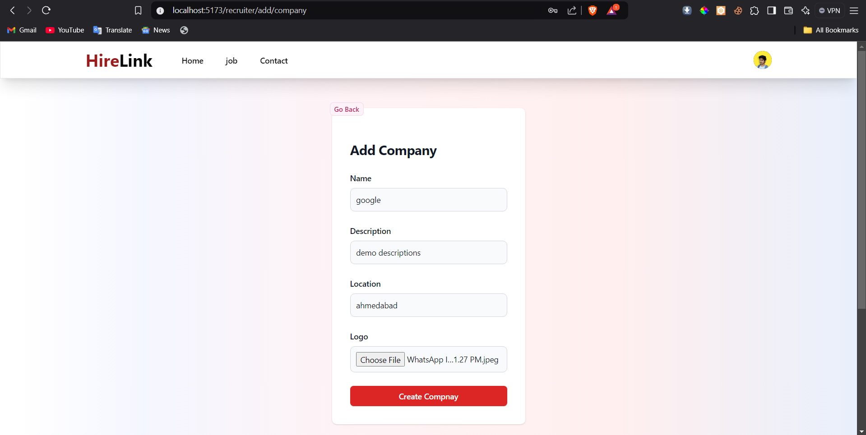
Input Design (Recruiter)
compnay register

Slide 42
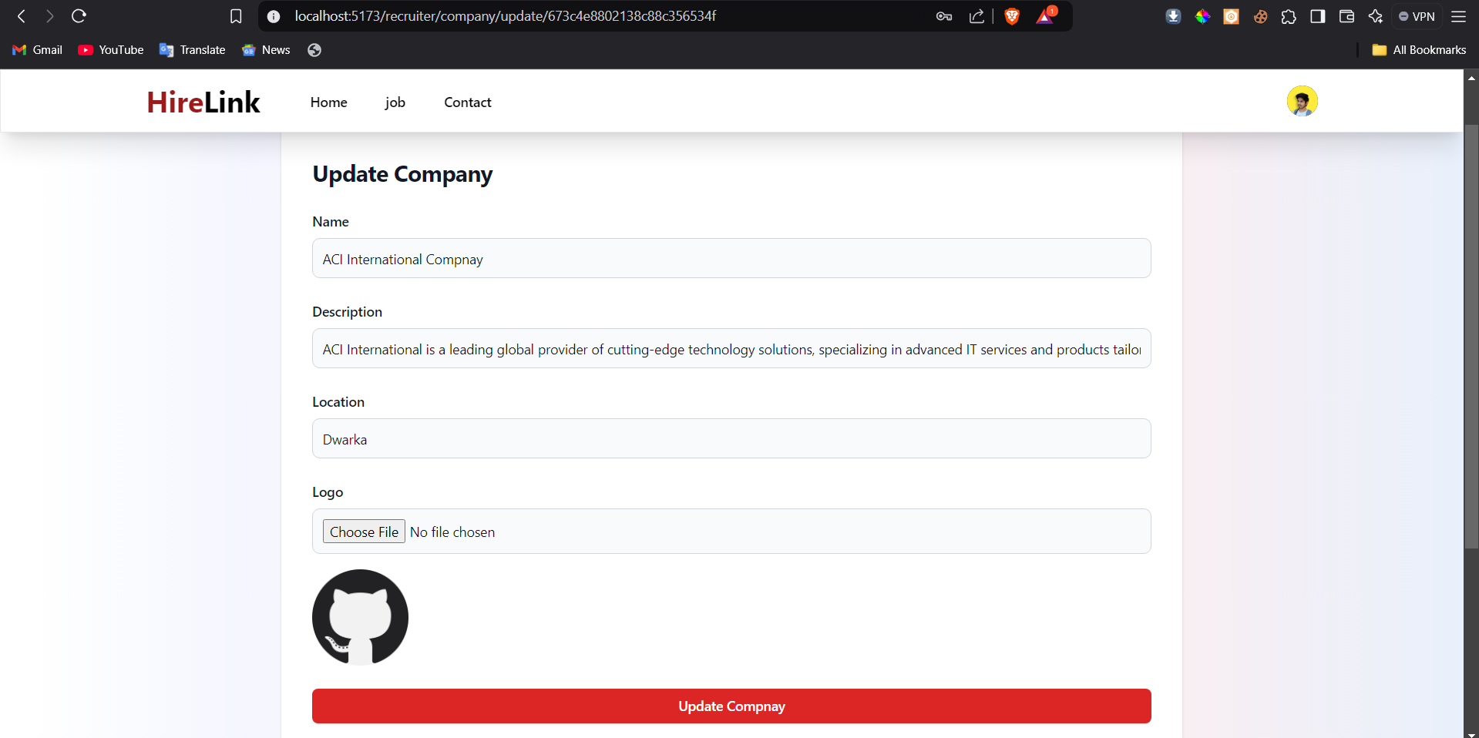
Input Design (Recruiter)
compnay update

Slide 43
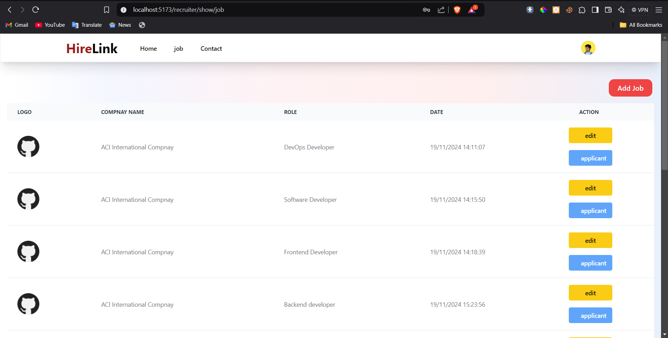
Input Design (Recruiter)
job page

Slide 44
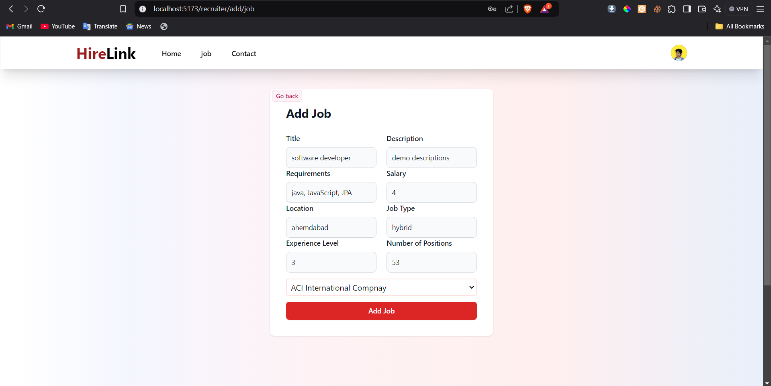
Input Design (Recruiter)
add job

Slide 45
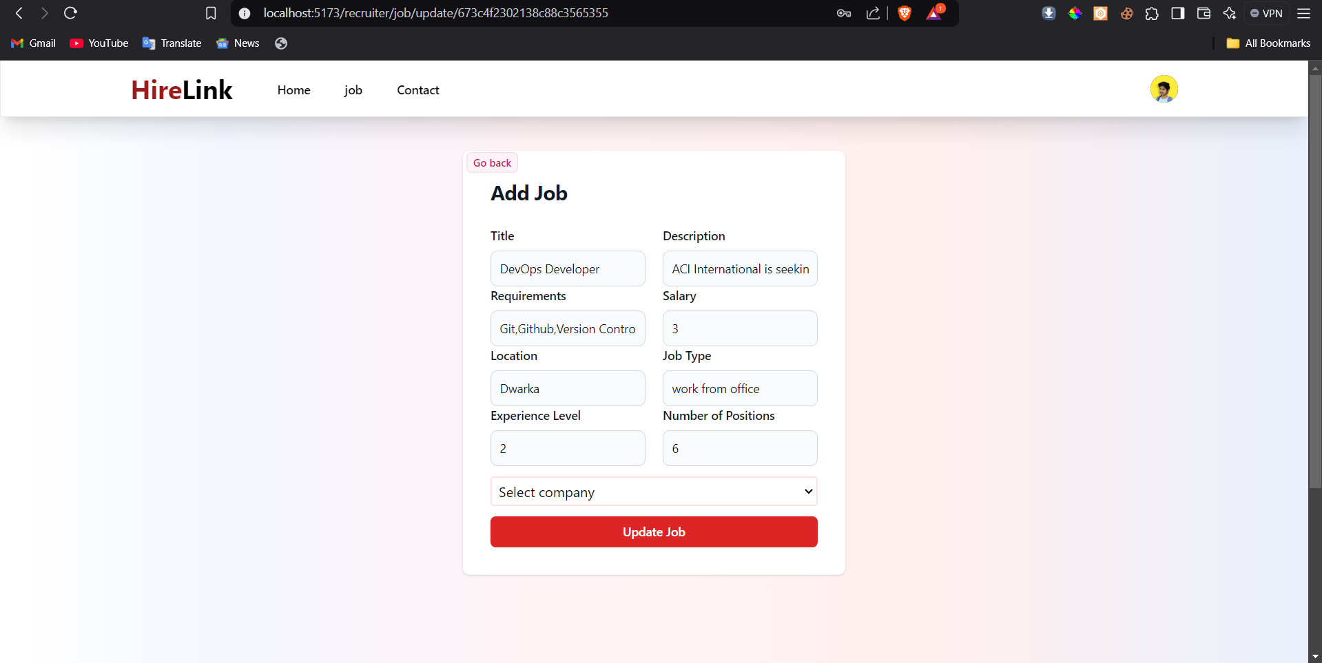
Input Design (Recruiter)
update job

Slide 46
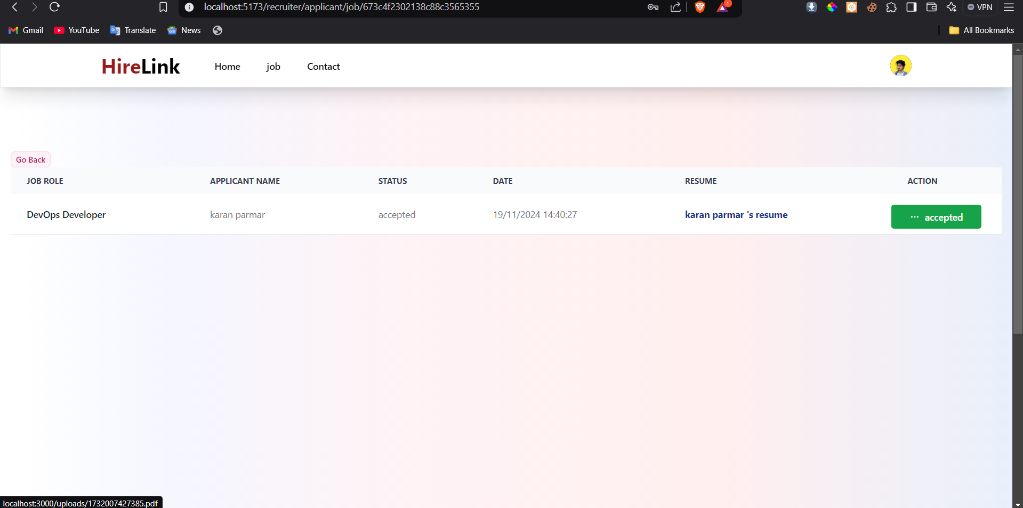
Input Design (Recruiter)
job applicant page

Slide 47
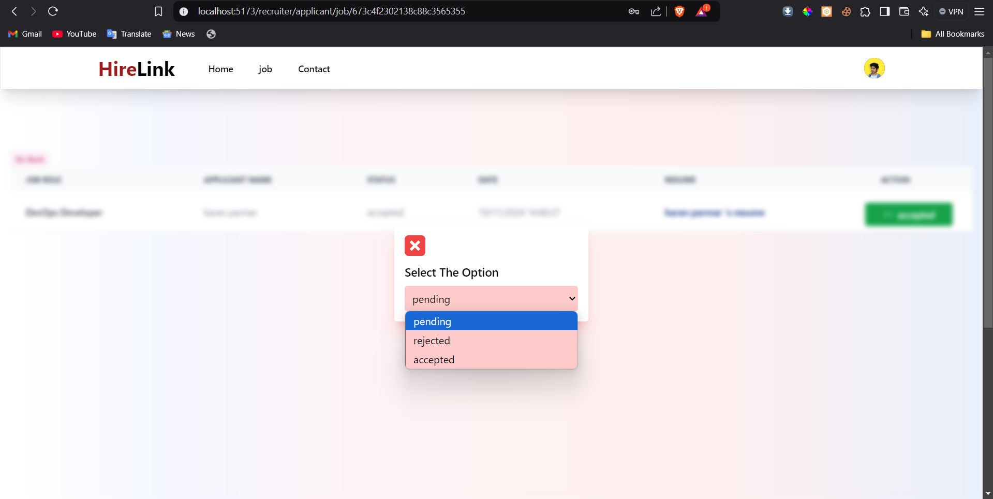
Input Design (Recruiter)
job applicant response

Slide 48
Testing
We have use following method for testing the system.
Specification Testing :-
▪ The specification testing is what program does in some various condition is.
▪ we check this system to give wrong username ,password, wrong data then system display message for input correct data.
Code Testing:-
▪ The code testing is examining the logic of program.
▪ we have testing all path of program, path means to specific combination of condition that handle by program.
Unit Testing:-
▪ Unit testing is focused on verifying small portion of functionality. Unit testing is important part where each module and process of application is to be test by possible input sets and desired output.
▪ we have check different type of modules like admin module, Visitor module etc

Slide 49
Post-Implementation Review
After the system is implemented and conversion is complete, user usually conducts a review of the system.
▪ In this system all Requirements are fulfills.
▪ The recruiter can easily add and update compnay information and job also.
▪ This system is user-friendly and easily understand.
▪ The performance level of users has improved.
▪ The new system needs less manpower, provides information at Time & saves data for document management.

Slide 50
Future Enhancement
Some are the expansion which we have thought of are:
▪ Try for to make system more user friendly.
▪ Improve search Facility.
▪ make it like linkedin platform where user can see the compnay throw search and visite any user profile like linkedin.

Slide 51
Bibliography
www.google.com
www.W3School.com
www.stakoverflow.com
www.geeksforgeeks.org
Pro MERN stack
MERN stack development express

Slide 52
THANK YOU

